Slide 1
ANN and Deep Learning
Dr. Sugata Ghosal
sugata.ghosal@pilani.bits-pilani.ac.in

Slide 2
In this segment
Perceptron for linear classification
Design of perceptron for
Boolean function
Linear classifier
Delta Rule

Slide 3
Linear Classification
Consider Following data
x₁ | X₂ | y
1 | 9 | Green
10 | 9 | Green
4 | 7 | Green
4 | 5 | Red
5 | 3 | Red
8 | 9 | Green
4 | 2 | Red
2 | 5 | Red
7 | 1 | Red
2 | 10 | Green
8 | 5 | Green
1 | 2 | Red
8 | 2 | Red
Data is in 2D, so let us visualize
x₂
x₁
Data looks linearly separable
What is the decision boundary?
Many Possibilities, such as
if (2x₁ + 3x₂ − 25 > 0) it is green
otherwise red

Slide 4

What about this arrangement?
With chosen decision boundary 2x₁ + 3x₂ − 25 = 0
x₂
-25
x₁
2
sign
x₂
3
x₁
This illustration is called as perceptron
Provides a graphical way to represent the linear boundary
Values 3, 2, -25 are its parameters or weights
Given a data
“How to find appropriate parameters?” is an important issue

Slide 5
Perceptron Training Rule
Algorithm: Perceptron training rule
1 Begin with random weights w
2 repeat
Different algorithms may converge to different acceptable hypotheses
3
4
for each misclassified example do
w_{i} = w_{i} + η(t − o)x_{i}
5 until all training examples are correctly classified;
6 return w
Why would this strategy converge?
Weight does not change when classification is correct
If perceptron outputs -1 when target is +1: weight increases ↑
If perceptron outputs +1 when target is -1: weight decreases ↓
Conversion with perceptron training rule is subject to linear separability of training example and appropriate η

Slide 6

An Example
x₁ x₂ Output
Consider a perceptron with output 0/1 as shown
0
0
0
x₀=+1
x₁
x2 w₂ =+20
w₀ =-30
0
1
0
w₁ =+20
σ(w ^{T} x )
1
0
0
1
1
1
Represents a linear decision boundary
x₂
This perceptron computes logical AND
w₀=-10 gives logical OR
w₀=10, w₁=-20 with single input gives logical NOT
XOR is not possible
+ve region
−30 + 20x₁ + 20x₂ = 0
-ve region
x₁

Slide 7

An Example
Design a perceptron for
We have following four equations
w₀ + w₁ × (0) + w₂ × (0) < 0 (1)
w₀ + w₁ × (0) + w₂ × (1) < 0 (2)
w₀ + w₁ × (1) + w₂ × (0) ≥ 0 (3)
w₀ + w₁ × (1) + w₂ × (1) < 0 (4)
X₁ | x₂ | Classification
0 | 0 | 0
0 | 1 | 0
1 | 0 | 1
1 | 1 | 0
By (1) w₀ < 0 so let w₀ = −1
Let us assume following
By (2) w₀+w₂<0 so let w₂ = −1
+1
By (3) w₀+w₁≥0 so let w₁ = 1.5
w₀
By (4) w₀+w₁+w₂<0 that is valid
x
w₁
σ(w ^{T} x )
So (w₀, w₁, w₂) = (−1, −1, 1.5)
1
Other possibilities are also there
x
2
w₂

Slide 8
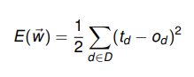
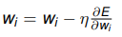
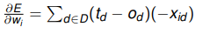
Perceptron Training (delta rule)
Delta rule converges to a best-fit approximation of the target
Uses gradient descent
Consider un-thresholded perceptron, i.e., output
Training error is defined as
Gradient would specify direction of steepest increase
Weights can be learned as
It can be seen that

Slide 9
Perceptron Training (delta rule)
Algorithm: Gradient Descent (D,η)
1 Initialize w_{i} with random weights
2 repeat
3
4
5
6
For each w_{i} , initialize δw_{i} = 0
for each training example d ∈ D do
Compute output o using model for d whose target is t
For each w_{i} , update δw_{i} = δw_{i} + η(t−o)x_{i}
7
For each w_{i} , set w_{i} = w_{i} + δw_{i}
8 until termination condition is met;
9 return w
A date item d ∈ D, is supposed to be multidimensional d = (x₁, x₂, ..., x_{n}, t )
Algorithm converges toward the minimum error hypothesis.
Linear programming can also be an approach

Slide 10
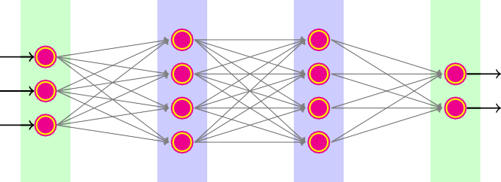
Neural Network
When neurons are interconnected in layers
Input Layer
Hidden Layer 1
Hidden Layer 2
Output Layer
Number of layers may differ
Nodes in each intermediate layers may also differ
Multiple output neurons are used for different class
Two levels deep NN can represent any Boolean function

Slide 11
An Example
Design a neural network for
x₁ | X₂ | Classification
0 | 0 | 0
0 | 1 | 0
1 | 0 | 1
1 | 1 | 0
x₁ | X₂ | x¯₂ | (x₁)AND(x¯₂)
0 | 0 | 1 | 0
0 | 1 | 0 | 0
1 | 0 | 1 | 1
1 | 1 | 0 | 0
x₀=+1
10
-30
x₁
0
20
-20
x₂
20
This arrangement is mostly avoided, as training is more challenging

Slide 12
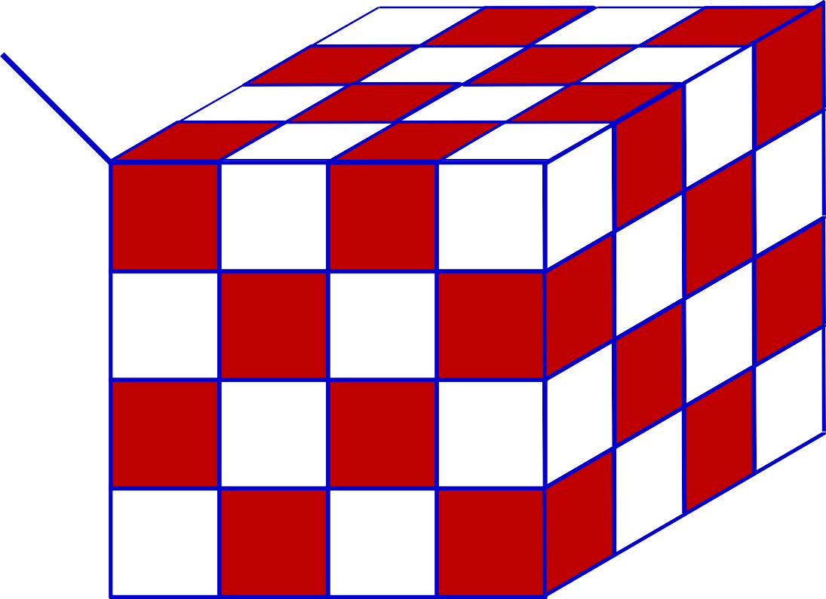
Width of a single-layer Boolean MLP
How many neurons in one hidden layer needed?
YZ
WX
00
01
11
10
10
11
01
YZ
_{UV} 00
00
01 11 10
Can be generalized: Will require 2^{N-1} perceptrons in hidden layer - Exponential in N
How many hidden nodes if multiple hidden layers are used?

Slide 13
More Example: Design NN for the following data
x₂
Red-line | Blue-line | Black-line | Color
0 | 0 | 0 | 1
0 | 0 | 1 | 0
0 | 1 | 0 | 1
0 | 1 | 1 | 1
1 | 0 | 0 | 1
1 | 0 | 1 | 1
1 | 1 | 0 | 1
1 | 1 | 1 | 1
Red Point
x₁
+1
+1
x₂ x₁
Input Layer
Hidden Layer 1
Hidden Layer 2
Output Layer

Slide 14




Neural Network Design
1
X₂
1
1
-1
0,1
-1
-1
X₁
X₂
X₁
X₂
-1,0
Output +1
1,0
X₁
1
1
1
1
0,-1
-1
1
X₁
X₂
-4
X₁
X₂
1
1
1
1
₁ -1
1
1
1
-1
1
Assuming simple perceptrons:
1
1
-1
-1
1
output = 1 if
i
i i
i
X₁
X₂

Slide 15
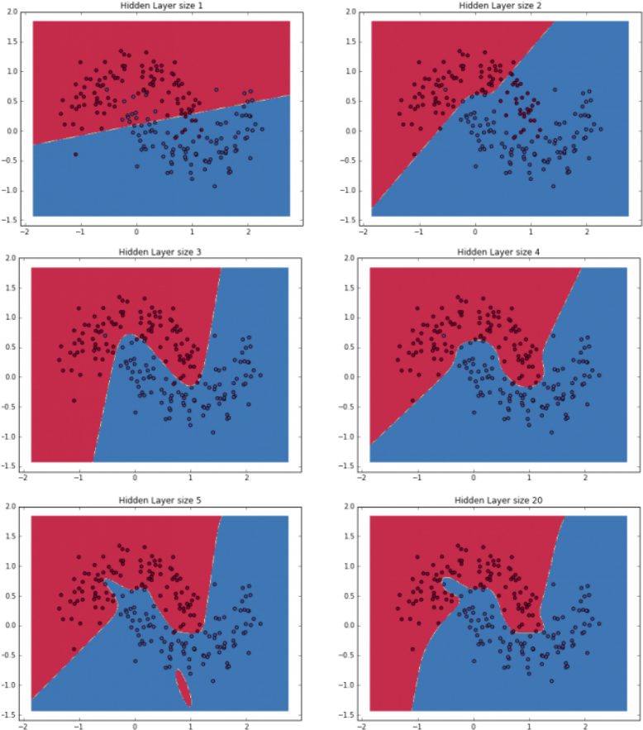
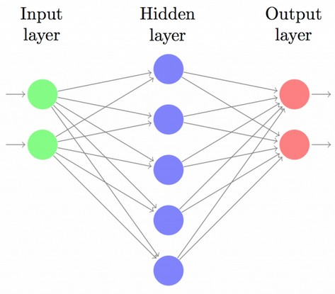
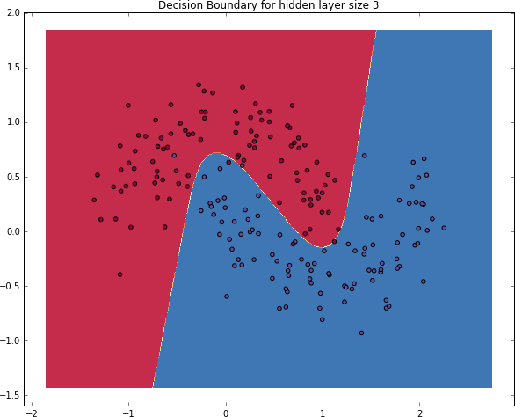
Nonlinear Decision Boundary
Effect of number of hidden nodes
¹https://github.com/dennybritz/nn-from-scratch/blob/master/nn-from-scratch.ipynb

Slide 16


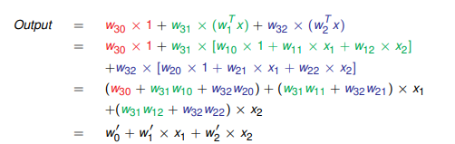
Linear Activation is Not Much Interesting
NN with perceptrons have limited capability, even with many layers
+1
+1
1
^{w}10
x₁ x₂
x₁
w₁ = w₁₁
w ^{T} x
x =
1
^{w}12
^{w}30
Output
w₃ = w₃₁
^{w}20
w ^{T} x
^{w}32
x₂
^{w}2 ^{= w}21
^{w}22
2
+1
_{w} I
0
I
x
w₁
w ^{T} x
1
x
2
_{w} I
2
Expression of single perceptron

Slide 17

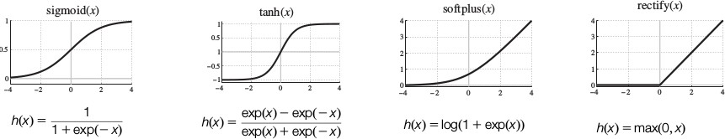
Neuron
Neuron uses nonlinear activation functions (sigmoid , tanh, ReLU, softplus etc.) at the place of thresholding
+1
sigmoid(x) tanh(x) softplus(x)
w₀
x₁
w₁
act(w ^{T} x )
1
0
x
x₂
w₂

Slide 18
Neural Network Applicability
NN is appropriate for problems with the following characteristics:
Instances are provided by many attribute-value pairs (more data)
The target function output may be discrete-valued, real-valued, or a vector of several real or discrete valued attributes
The training examples may contain errors
Long training times are acceptable
Fast evaluation of the target function may be required
The ability of humans to understand the learned target function is not important

Slide 19
Backpropagation

Slide 20
Session Content
Backpropagation Algorithm
Behavior of Backpropagation

Slide 21
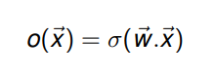
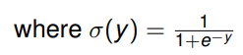
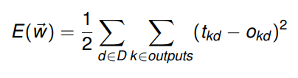
Multilayer Networks and Backpropagation
Single perceptron can only express linear decision surface
We need units whose output is a nonlinear function of its inputs AND is also differentiable (Use Neuron not Perceptron)
Backpropagation algorithm learns the weights for a fixed set of units and interconnection
It employs gradient descent to minimize the error between the network output values and the target values for these outputs
Let Error function is redefined as

Slide 22
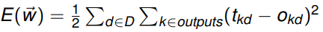
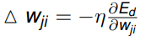
Backpropagation (for 2 layers)
Algorithm: Backpropagation(D,η,n_{in},n_{out} ,n_{hidden})
1 Create the feedforward network with n_{in} , n_{out} , n_{hidden} layers
2 Randomly initialize weights to small values ∈ [−0.05, +0.05]
3 repeat
4
5
6
7
8
for each ∈ D do
o_{u} = get output from network ∀ unit u
δ_{k} = o_{k} (1 − o_{k} )(t_{k} − o_{k} ) for all output unit k
δ_{h} = o_{h} (1 − o_{h} )
(w δ ) for all hidden unit h
w_{ji} = w_{ji} + ∆w_{ji} where ∆w_{ji} = ηδ_{j} x_{ji}
9 until converge;
Recall error function is
For a single training example
Weight w_{ji} is updated by adding

Slide 23
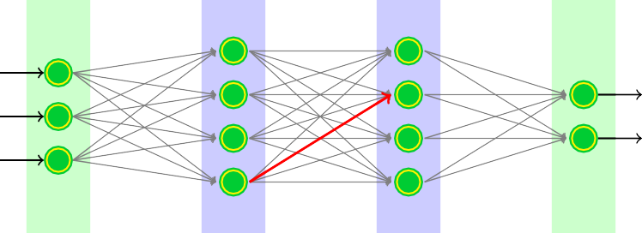
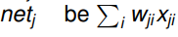
Conventions Over The Network
4
5
6
7
8
9
10
11
1
2
3
12
13
xji wji
i th input to unit j (x₉₇ is highlighted)
weight associated with i th input to unit j
the weighted sum of input for unit j
output computed by unit j . Let it be σ(net_{j} )
target output for unit j as specified in training set
set of units in final layer ({12, 13} in this case)
units whose immediate input is the output of unit j
o_{j}
t_{j}
outputs
Downstream(j )
∂E
∂E
∂net
∂E
We are interested in it is
×
j
and therefore,
× x
d
d
d
ji
∂w_{ji}
∂net_{j} ∂w_{ji}
∂net_{j}

Slide 24
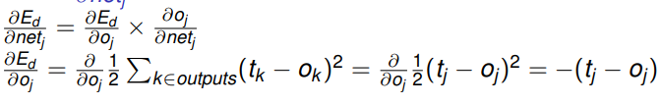
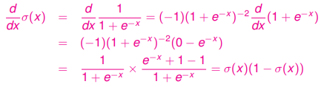
Value of ^{∂Ed} for output units
∂net_{j}
Note that o_{j} = σ(net_{j} ) therefore ^{∂oj} is derivative of sigmoid
∂net_{j}
As a result
∂o
j
=
∂σ(net )
= σ(net_{j} )(1 −
σ(net ))
= o_{j} (1 − o_{j} )
j
j
∂net_{j} ∂net_{j}
∂E
d
= −(t_{j} − o_{j} )o_{j} (1 − o_{j} )
∂net_{j}
Term (t_{j} − o_{j} )o_{j} (1 − o_{j} ) is treated as δ_{j}

Slide 25
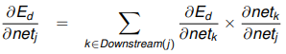
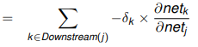
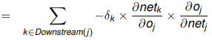
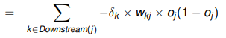
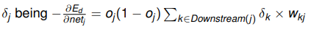
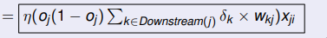
Value of ^{∂Ed} for hidden units
∂net_{j}

Slide 26
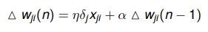
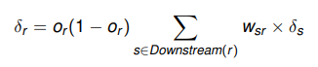
Momentum Based Weight Updates
Adding Momentum: weight update during n^{th} iteration depend partially on the update that occurred during the (n − 1)^{th} iteration
Learning in arbitrary acyclic network: for feed-forward networks of arbitrary depth, δ_{r} value for a unit in hidden layer is determined as

Slide 27
Backpropagation Behavior
Result of Backpropagation over multilayer networks is only guaranteed to converge toward some local minimum and not necessarily to the global minimum error
No methods are known to predict with certainty when local minima will cause difficulties
Suggested to use multiple networks (initialized with different random weights)
Any boolean function can precisely be represented by some network having only two layers of units (Cybenko 1989; Hornik et al. 1989)

Slide 28
Introduction to Deep Learning
Dr. Sugata Ghosal

Slide 29
Session Content
General machine learning pipeline
Characteristics of Deep Learning
Error Surface
Hyperparameters

Slide 30
General ML Pipeline
input
Quality
Check
Enhancement
Feature
Extraction
Database
Matching
Decision
Deep Learning can provided end-to-end learning

Slide 31
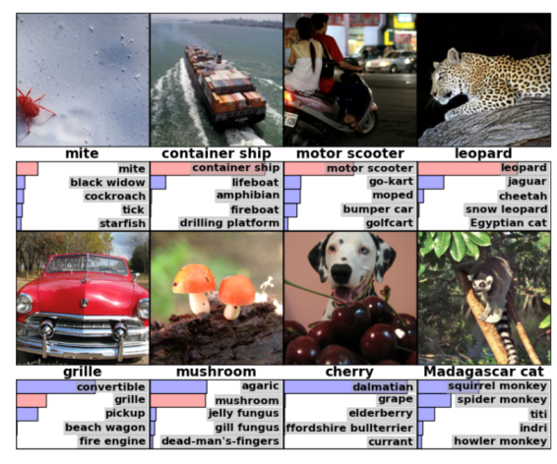
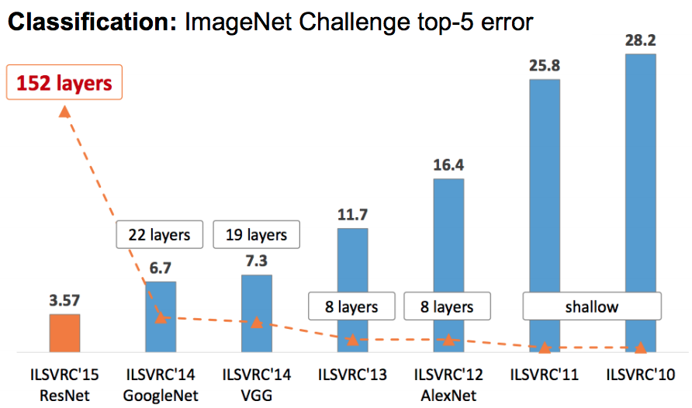
Deep Learning (DL)
Deep neural networks are capable of solving very complex problems
ImageNet Challenge (2011): identify objects in images
4 million images in 21841 categories [Challenge 1000 categories]

Slide 32
Key Points
DL is constructing network of parameterized functional modules and training them from examples using gradient based optimization – Yann Lecun
Traditional way to hand engineer feature is brittle and not scalable
Why now? because we have data (ImageNet …), compute power (GPUs) and software (tensorFlow)
DL learns underlying features/representations directly from data.
DL have been found useful to many real life problems. Capable of solving very complex problems.
As the data increases algorithm DL becomes better
Deep learning is NOT just adding more layers to a neural network.

Slide 33
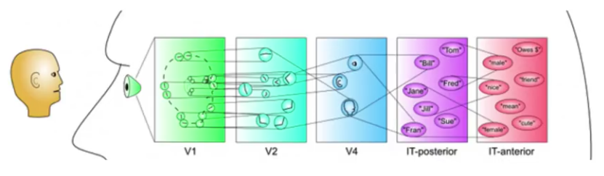
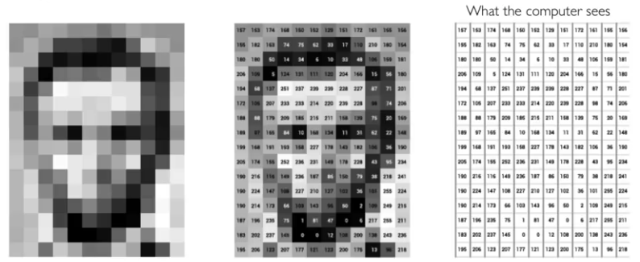
Visual Cortex is Hierarchical
DL helps to get hierarchy of features
Visual Cortex is Hierarchical
Images are numbers (so determine feature)
There could be occlusion, viewpoint variation, scale variation, illumination variation, deformation, background clutter, noise, intra-class variation and much more.

Slide 34
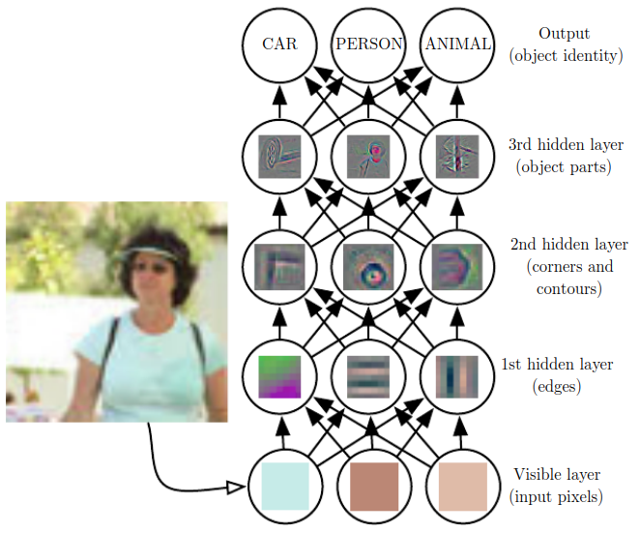
DL Builds Hierarchy of Features
Higher (or deeper) layers represents abstraction of the increasing complex features

Slide 35
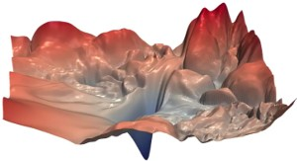
Error Surface
Backpropagation over multilayer networks is only guaranteed to converge toward some local minimum and not necessarily to the global minimum error
In deeper networks, often local minima is close to global minima
But, number of saddle point grows exponentially with depth of the network
Stochastic gradient descent owing to noise in gradient calculation is efficient in escaping saddle point during training of deep networks

Slide 36
Hyperparameter Tuning
There are many interesting questions for the network
How many layers?
How many units in each layer?
What should be the learning rate?
What is right activation function? etc.
Difficult to answer in the beginning
It is an iterative process
Demo
https://playground.tensorflow.org/

Slide 37
DEEP LEARNING AND ANN Regularization

Slide 38
Session Content
Underfitting Vs. Overfitting
L2 regularization
Dropout
Data Augmentation
Early Stopping

Slide 39
Which side do you want to be?
Train:Validation:Test split 60:20:20 or 99:1:1
High
(3rd choice)
I don’t want
to be here!
Testing Error
Risk of overfitting
This is even better
(1st choice)
This is better
(2nd choice)
Low
High
Training Error
Low training error comes with a risk of overfitting (high variance)

Slide 40
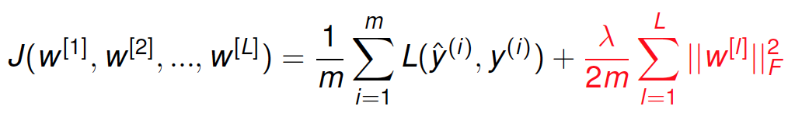
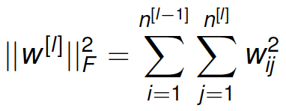
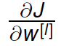
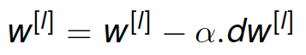
Regularization for NN
As there could be L layers each with their parameters so
where frobenius norm is
How you update the parameter earlier?
Get
dw^{[l]} = (from backpropagation)
then

Slide 41
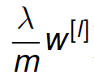
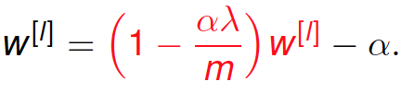
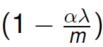
Regularization for NN (contd…)
With regularization term dw^{[l]} = (from backpropogation) +
Therefore the update is modified to
w^{[l]} = w^{[l]} – α.((from backpropagation) + )
Which is
(from backpropagation)
Due to the factor, this update method is also called weight decay
Our objective here is to penalize the weight matrices being too large

Slide 42
Penalize the weight matrices from being too large
With low weight, the connection get weakened so network has effectively less connections and become simpler.
Another intuition is that, when weights are lower, the output of the units is also lower. Assume activation function be tanh small input values tends to produce linear output.
So overall network tends to becomes linear (more biased)

Slide 43
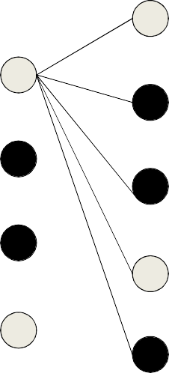


















Dropout Regularization
Randomly shutdown some of the units
Input
Input
Output
Output
X₁
Y₁
X₂
Y₂
Drop probabilities for different layers may be different

Slide 44
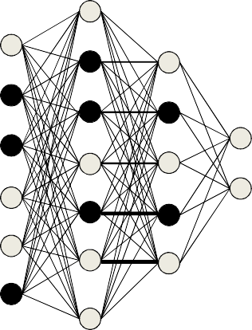
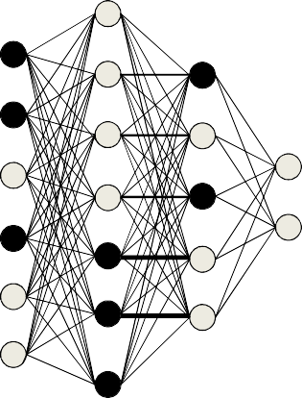
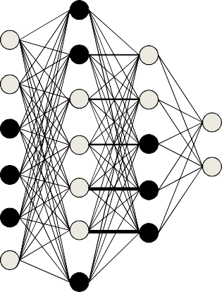
Dropout
Input
Input
Input
Output
Output
Output
X₁
Y₁
X₂
Y₂
X₃
Y₃
The pattern of dropped nodes changes for each input, i.e., in every pass through the net
•

Slide 45
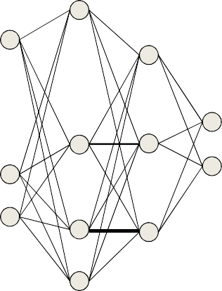
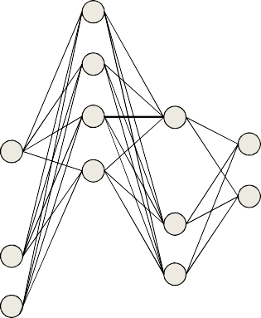
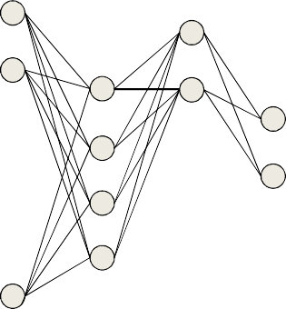
Dropout
Input
Input
Input
Output
Output
Output
X₁
Y₁
X₂
Y₂
X₃
Y₃
During training: Backpropagation is effectively performed only over the remaining network
The effective network is different for different inputs
Gradients are obtained only for the weights and biases from “On” nodes to “On” nodes
For the remaining, the gradient is just 0

Slide 46
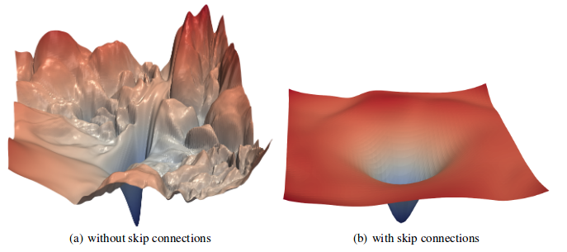
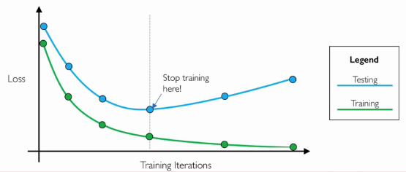
Regularization
Dropout
Visualizing the Loss Landscape of Neural Nets, Hao Li, Zheng Xu, Gavin Taylor, Christoph Studer, Tom Goldstein, 2018
Early stopping

Slide 47
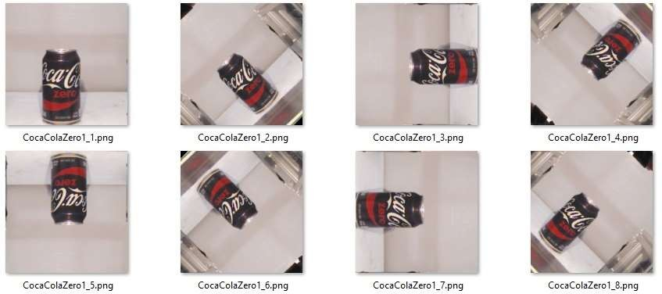
Other Regularization Methods
Increase the data by data augmentation
Flip, rotate, scale, translate, deform ....
Normalize training examples to speed up your training

Slide 48
Early Stopping
Continue training until the error on the training examples falls below some predetermined threshold could be a poor strategy
Weight decay or use of validation set (k -fold cross validation) is suggested
Input or output encoding can be used
Error
Error
Error
Testing
Testing
Training
Training
Training

Slide 49
DEEP LEARNING AND ANN (Weight Initialization and Update)
Dr. Sugata Ghosal

Slide 50
Session Content
Weight Initialization
Momentum based weight updates
Nestorov Method
RMS Prop
ADAM

Slide 51

Weight initialization
Exploding and vanishing gradient is an issue during training deep networks
Set the variance of weights to be 1/n
For ReLu activation function, it is better to use variance as 2/n
For tanh activation, use variance as called Xavier initialization

Slide 52

Deep MLP: Code Snippet
Configure Training Parameters
Train the Model

Slide 53







Momentum Update
Plain gradient update With momentum
The momentum method maintains a running average of all gradients until the current step
(k) (k–1) (k–1)
𝑇
=
W
(k) (k–1) (k)
– Typical value is 0.9
The running average steps
Get longer in directions where gradient stays in the same sign
Become shorter in directions where the sign keeps flipping
=

Slide 54







Momentum Update
$Δ$W^{(k-1)}
W^{(k)}
W^{(k-1)}
At any iteration, to compute the current step
First computes the gradient step at the current location
Then adds in the scaled previous step
which is actually a running average
To get the final step
T

Slide 55











Nestorov’s Accelerated Gradient
$Δ$W^{(k-1)}
W^{(k-1)}
W^{(k)}

Slide 56
Smoothing the trajectory
Step | X component | Y component
1 | 1 | +2.5
2 | 1 | -3
3 | 3 | +2.5
4 | 1 | -2
5 | 2 | 1.5
1 2
4
3
5
Simple gradient and acceleration methods still demonstrate oscillatory behavior in some directions
Depends on magic step size parameters
Observation: Steps in “oscillatory” directions show large total movement
In the example, total motion in the vertical direction is much greater than in the horizontal direction
Improvement: Dampen step size in directions with high motion
Using second order term

Slide 57

Normalizing steps by second moment
In recent past
Total movement in Y component of updates is high
Movement in X components is lower
Current update, modify usual gradient-based update:
Scale down Y component movement
Scale up X component movement
According to their variation (and not just their average)
A variety of algorithms have been proposed on this premise
e.g., RMS Prop, ADAM

Slide 58



RMS Prop
This is a variant on the basic mini-batch SGD algorithm
Modified update rule: We want to
scale down updates with large mean squared derivatives of Loss w.r.t. w’s
scale up updates with small mean squared derivatives
Notation
Updates are by parameter
Sum derivative of loss w.r.t any individual parameter w shown as = $\frac{δLoss}{δw}$
The squared derivative is
short-hand notation represents the squared derivative, not the second derivative
The mean squared derivative is a running estimate of the average squared derivative.
We will show this as
w
2 2
w w
w

Slide 59


RMS Prop
Procedure
Maintain a running estimate of the mean squared value of derivatives for each parameter
Scale update of the parameter by the inverse of the root mean squared derivative
Typical parameters $η=0.001, γ=0.9$
k denotes the iteration number.

Slide 60


ADAM: RMSprop with momentum
RMS prop only considers a second-moment normalized version of the current gradient
ADAM utilizes a smoothed version of the momentum-augmented gradient
Considers both first and second moments
Procedure
Maintain a running estimate of the mean derivative for each parameter
Maintain a running estimate of the mean squared value of derivatives for each parameter
Scale update of the parameter by the inverse of the root mean squared derivative
Typical parameters $η=0.001 , δ=0.9 , γ=0.9$99
In initial iterations, smoother trajectory is ensured than in later iterations.

